Slide 1

Making Password Checking Systems Better
Tom Ristenpart
Covering joint work with:
Anish Athayle, Devdatta Akawhe, Joseph Bonneau, Rahul Chatterjee, Adam Everspaugh, Ari Juels, Sam Scott

Slide 2

Password checking systems
tom, password1
tom | password1
alice | 123456
bob | p@ssword!
Login
server
(plus hundreds of millions more)
Allow login if:
Attack detection mechanisms don’t flag request
Password matches
Sometimes: second factor succeeds

Slide 3
Password checking systems
tom, password1
tom | password1
alice | 123456
bob | p@ssword!
Login
server
(plus hundreds of millions more)
Allow login if:
Attack detection mechanisms don’t flag request
Password matches
Sometimes: second factor succeeds

Slide 4
Problems w/ password checking systems
tom, password1
tom | password1
alice | 123456
bob | p@ssword!
Login
server
People often enter
wrong password:
Typos
Memory errors
Passwords databases must be protected:
Server compromise
Exfiltration attacks (e.g., SQL injection)
Widespread practice:
Apply hashing w/ salts
Hope slows down attacks enough

Slide 5
Today’s talk
Pythia: moving beyond “hash & hope”
Harden hashes with off-system secret key using
partially oblivious pseudorandom function protocol
[Everspaugh, Chatterjee, Scott, Juels, R. – USENIX Security 2015]
Typo-tolerant password checking
In-depth study of typos in user-chosen passwords
Show how to allow typos without harming security
[Chatterjee, Athayle, Akawhe, Juels, R. – Oakland 2016]
NoCrack: password-vault based honey encryption
Decrypting a ciphertext with any number of *wrong* passwords yields fake, but plausible, plaintexts
[Juels, R. – Eurocrypt 2014]
[Chatterjee, Bonneau, Juels, R. – Oakland 2015]

Slide 6
Password checking systems
tom | password1
alice | 123456
bob | p@ssword!
tom, password1
tom | salt₁ , H^{c}(password1,salt₁)
alice | salt₂ , H^{c}(123456,salt₂)
bob | salt₃ , H^{c}(p@ssword!,salt₃)
Login
server
Websites should never store passwords directly,
they should be (at least) hashed with a salt (also stored)
Cryptographic hash function H
(H = SHA-256, SHA-512, etc.)
c times
H
H
…
H
Common choice is c = 10,000
pw||salt
Better: scrypt, argon2
UNIX password hashing scheme, PKCS #5
Formal analyses: [Wagner, Goldberg 2000] [Bellare, R., Tessaro 2012]

Slide 7
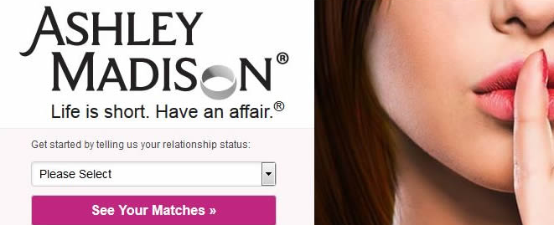
AshleyMadison hack: 36 million user hashes
Salts + Passwords hashed using bcrypt with c = 2¹² = 4096
4,007 cracked directly with trivial approach
290729 123456
79076 12345
76789 123456789
59462 password
49952 iloveyou
33291 princess
…
Password cracker
List of possible passwords in
order of their likelihood
Recompute hash and check
Examples: Hashcat, Johntheripper, academic projects

Slide 8
AshleyMadison hack: 36 million user hashes
Salts + Passwords hashed using bcrypt with c = 2¹² = 4096
4,007 cracked directly with trivial approach
CynoSure analysis: 11 million hashes cracked
>630,000 people used usernames as passwords
MD5 hashes left lying around accidentally
http://cynosureprime.blogspot.com/2015/09/csp-our-take-on-cracked-am-passwords.html

Slide 9
A voyeuristic tour of passwords
mypasswordispassword
superhardpassword
thebestpasswordever
thisisagoodpassword
ishouldnotbedoingthis
ithinkilovemywife
thisiswrong
whatthehellamidoing
likeimreallygoingtocheat
justcheckingitout
justtryingthisout
goodguydoingthewrongthing
http://cynosureprime.blogspot.com/2015/09/csp-our-take-on-cracked-am-passwords.html

Slide 10

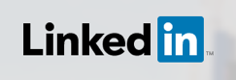


AshleyMadison in good company
…
32.6 million leaked (2012)
32.6 million recovered (plaintext!)
6.5 million leaked (2012)
5.85 million recovered in 2 weeks
442,832 leaked (2012)
442,832 recovered
36 million accounts leaked (2013)
Encrypted, but with ECB mode
…

Slide 11
(1) Password protections often implemented
incorrectly in practice
(2) Even in best case, hashing slows down but does not prevent password recovery

Slide 12

Facebook password onion
$cur = ‘password’
$cur = md5($cur)
$salt = randbytes(20)
$cur = hmac_sha1($cur, $salt)
$cur = remote_hmac_sha256($cur, $secret)
$cur = scrypt($cur, $salt)
$cur = hmac_sha256($cur, $salt)

Slide 13


Strengthening password hash storage
tom, password1
h
K
f = HMAC(K, h)
Back-end
crypto
service
h = H^{c}(password1|| salt)
Store salt, f
HMAC is pseudorandom function (PRF).
f’ = H^{c}(123456 || salt)
f = f’?
f’ = HMAC(K, h’)
K
H^{c}(1234567 || salt)
Back-end
crypto
service
Must still perform online
brute-force attack
Exfiltration doesn’t help
H^{c}(12345 || salt)
…

Slide 14
Strengthening password hash storage
tom, password1
h
K
f = HMAC(K, h)
Back-end
crypto
service
h = H^{c}(password1|| salt)
Store salt, f
Critical limitation: can’t rotate K to a new secret K’
Idea 1: Version database and update as users log in
But doesn’t update old hashes
Idea 2: Invalidate old hashes
But requires password reset
Idea 3: Use secret-key encryption instead of PRF
But requires sending keys to web server (or high bandwidth)

Slide 15
The Pythia PRF Service
Blinding means service learns nothing about passswords
tom, password1
user id, blinded h
K
Blinded PRF output f
Back-end
crypto
service
h = H^{c}(password1|| salt)
Blind h, pick user ID
Unblind PRF output f
Store user ID, salt, f
User ID reveals fine-grained query patterns to service.
Compromise detection & rate limiting
Cryptographically erases f:
Useless to attacker in the future
Combine token and f
to generate f’ = F(K’,h)
K
Token(K->K’)
Back-end
crypto
service
Server learns nothing about K or K’
K’

Slide 16
New crypto: partially-oblivious PRF
Groups G₁ , G₂ , G_{T} w/ bilinear pairing e : G₁ x G₂ -> G_{T} e(a^{x},b^{y}) = c^{xy}
K
tom, password1
user id, h^{r}
y
t = H(user id)
y = e(t^{K},h^{r})
h = H^{c}(password1|| salt)
Choose random r
f = y^{1/r}
Store user ID, salt, f
f = e(t^{K},h^{r})^{1/r} = e(t,h)^{Kr*1/r} = e(t,h)^{K}
Pairing cryptographically binds user id with password hash
Can add verifiability (proof that PRF properly applied)
Key rotation straightforward: Token(K -> K’) = K’ / K
Interesting formal security analysis (see paper)

Slide 17




The Pythia PRF Service
Queries are fast despite pairings
PRF query: 11.8 ms (LAN) 96 ms (WAN)
Parallelizable password onions
H^{c} and PRF query made in parallel (hides latency)
Multi-tenant (theoretically: scales to 100 million servers)
Easy to deploy
Open-source reference implementation at
http://pages.cs.wisc.edu/~ace/pythia.html

Slide 18
Today’s talk
Pythia: moving beyond “hash & hope”
Harden hashes with off-system secret key using
partially oblivious pseudorandom function protocol
[Everspaugh, Chatterjee, Scott, Juels, R. – USENIX Security 2015]
Typo-tolerant password checking
In-depth study of typos in user-chosen passwords
Show how to allow typos without harming security
[Chatterjee, Athayle, Akawhe, Juels, R. – Oakland 2016]

Slide 19
Back to our big picture
tom | password1
alice | 123456
bob | p@ssword!
tom, password1
tom | G_{K}(password1)
alice | G_{K}(123456)
bob | G_{K}(p@ssword!)
Login
server
People often enter
wrong password:
Typos
Memory errors
Passwords databases must be protected:
Server compromise
Exfiltration attacks (e.g., SQL injection)
Widespread practice:
Apply hashing w/ salts
Hope slows down attacks enough

Slide 20
Back to our big picture
tom | password1
alice | 123456
bob | p@ssword!
tom, password1
tom | G_{K}(password1)
alice | G_{K}(123456)
bob | G_{K}(p@ssword!)
Login
server
People often enter
wrong password:
Typos
Memory errors
Users have hard time remembering (complex) passwords
[Ur et al. 2012] [Shay et al. 2012] [Mazurek et al. 2013] [Shay et al. 2014]
[Bonneau, Schechter 2014]
Passwords can be difficult to enter without error (typo)
[Keith et al. 2007, 2009] [Shay et al. 2012]
Suggestions for error-correcting passphrases
[Bard 2007] [Jakobsson, Akavipat 2012] [Shay et al. 2012]

Slide 21
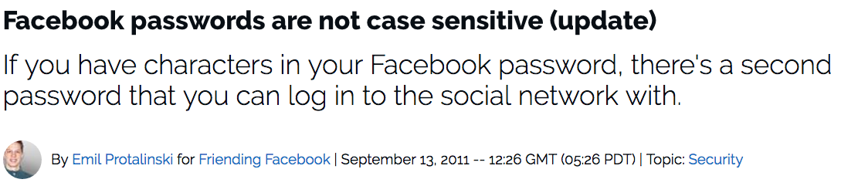
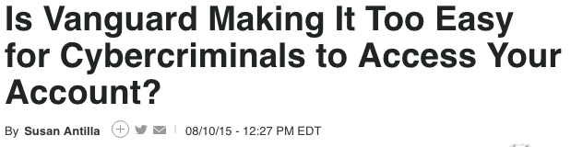

Slide 22
Typo-tolerance in passwords
tom, Password1
tom | password1
alice | 123456
bob | p@ssword!
tom | G_{K}(password1)
alice | G_{K}(123456)
bob | G_{K}(p@ssword!)
tom, PASSWORD1
Both versions accepted by Facebook (go try it yourself!)
Presumably checking:
G_{K}(Password1) G_{K}(password1) G_{K}(pASSWORD1)
G_{K}(PASSWORD1) G_{K}(password1) G_{K}(pASSWORD1)
Intuition is that this represents a security problem
tom | password1
alice | 123456
bob | p@ssword!
tom, password
tom | G_{K}(password1)
alice | G_{K}(123456)
bob | G_{K}(p@ssword!)
fail
Can rule out 3
possible passwords!
3x speed-up in guessing attacks???

Slide 23





Our work
Transcription experiment to identify frequent typos
Many typos easily correctable
Analyze typos & their impact for Dropbox users (100s of millions)
Typos huge burden on users / businesses
Formalize typo-tolerant checking
Prove “free corrections theorem”
In theory, can correct typos
w/o security loss
Analyze practical security via simulated attacks using password leaks as data
In practice, too

Slide 24
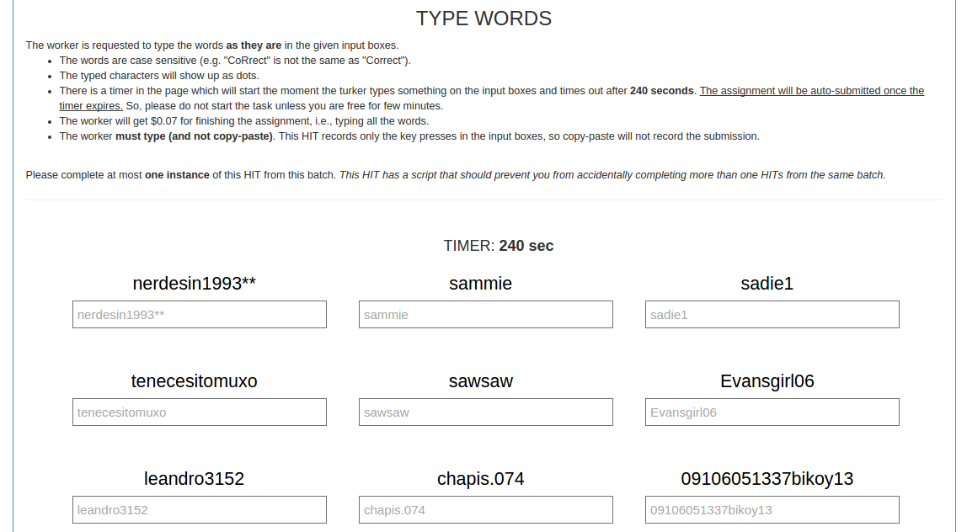
MTurk transcription experiment

Slide 25
MTurk transcription experiment
Passwords sourced from RockYou password leak.
Transcription (as opposed to recall experiments) allowed
faster data gathering. 100k passwords submitted for entry
CMU MTurk data provided qualitatively similar results
Typo | Example | % of errors
Caps lock | password1 -> PASSWORD1 | 10.9%
Case 1st letter | password1 -> Password1 | 4.5%
Extra char end | password1 -> password12 | 4.3%
Extra char front | password1 -> apassword1 | 1.3%
Last symbol to number | password! -> password1 | 0.2%
Proximity errors | password1 -> psssword1 | 21.8%
Transcription errors | passwordi -> password1 | 3.0%
Other | --- | 53.6%
Examples of easily
correctable typos
Hard to correct

Slide 26
Relaxed typo-tolerant checkers
tom | password1
alice | 123456
bob | p@ssword!
tom, Password1
tom | G_{K}(password1)
alice | G_{K}(123456)
bob | G_{K}(p@ssword!)
Easily-corrected typos admit simple correctors:
f_{caps}(x) = x with case of all letters flipped
f_{1st-case}(x) = x with first letter case flipped, if it is letter
…
Define set C of corrector functions. Let h = G_{K}(password1)
Relaxed checker:
If G_{K}(Password1) = h then Return 1
For each f in C:
If G_{K}( f(Password1) ) = h then Return 1
Return 0
Works with Pythia:
No change to security after compromise
Error-correction from error-detection via ball search

Slide 27

Dropbox experiments
tom, Password1
Instrumented password checks to evaluate typo prevalence:
If G_{K}(Password1) = h then Return 1
For each f in C:
If G_{K}( f(Password1) ) = h then Log f as successful
Return 0
Did not change effective
authentication policy
100s of millions of users
Two 24-hour runs (Top 5 then Top 3 correctors)
Can’t give all statistics due to confidentiality reasons

Slide 28
Dropbox experiments: Top 5
tom, Password1
Instrumented password checks to evaluate typo prevalence:
Typo | Example | % of failures
Caps lock | password1 -> PASSWORD1 | 1.13%
Case 1st letter | password1 -> Password1 | 5.56%
Extra char end | password1 -> password12 | 2.05%
Extra char front | password1 -> apassword1 | 0.35%
Last symbol to number | password! -> password1 | 0.21%
Total: 9.30%

Slide 29
Dropbox experiments: Top 3
20% of users that resubmitted would have saved a minute with typo tolerance
Typo tolerance would add several person-months of login time
3% of users couldn’t log in during 24 hour period, but could have with one of Top 3 correctors

Slide 30
Our work
Transcription experiment to identify frequent typos
Many typos easily correctable
Analyze typos & their impact for Dropbox users (100s of millions)
Typos huge burden on users / businesses
Formalize typo-tolerant checking
Prove “free corrections theorem”
In theory, can correct typos
w/o security loss
Analyze practical security via simulated attacks using password leaks as data
In practice, too

Slide 31
Online guessing speedup fallacy
tom | password1
alice | 123456
bob | p@ssword!
tom, password
tom | G_{K}(password1)
alice | G_{K}(123456)
bob | G_{K}(p@ssword!)
fail
Can rule out 3
possible passwords if
correct C_{top2}
3x speed-up in guessing attacks???

Slide 32
Online guessing attacks
Stored password is G_{K}(password1)
tom, 123456
Check G_{K}(123456)
Password list
fail
Check G_{K}(12345)
pw₁ = 123456
pw₂ = 12345
pw₃ = password
pw₄ = iloveyou
pw₅ = Password
…
tom, 12345
Given budget q of queries
Pr[success] ≤ λ_{q} = Σ_{i=1..q} Pr[ pw_{i} ]
fail
…
Typo tolerant case (e.g., C_{top2})
tom, 123456
Stored password is G_{K}(password1)
Check G_{K}(123456)
fail
Password list
Check G_{K}(password) G_{K}(Password)
G_{K}(PASSWORD)
pw₁ = 123456
pw₂ = 12345
pw₃ = password
pw₄ = iloveyou
pw₅ = Password
…
tom, password
Let λ_{q} be maximal success probability
Finding optimal sequence of queries is NP-hard. Approximate w/ greedy
*
fail
…

Slide 33
Security gap between exact and tolerant?
Best-case
Worst-case
All passwords typos of another. Passwords uniformly distributed
No password typo of another
λ_{q} = λ_{q}
λ_{q} = 3 λ_{q}
*
*
pw₁ = 123456
pw₂ = 12345
pw₃ = password
pw₄ = iloveyou
pw₅ = password1
pw₆ = password123
pw₁ = password
pw₂ = PASSWORD
pw₃ = Password
pw₄ = Loveyou
pw₅ = loveyou
pw₆ = LOVEYOU
Situations in practice will lie somewhere in between:
λ_{q} ≤ λ_{q} ≤ 3 λ_{q}
*

Slide 34
Free corrections theorem
Thm. For any password distribution, set of correctors C, and adversarial query budget q, there exists a typo-tolerant checker for which λ_{q} = λ_{q} .
*
Construction:
For any password, check as many typos as one can while ensuring correctness and that Σ_{pw in} _{ball} Pr[ pw ] ≤ Pr[pw_{q}]
Ensures optimal adversarial strategy is to query pw₁,…,pw_{q} against typo-tolerant checker. Same as for strict checker
(1) Theorem rests on construction
knowing exact password distribution
Remaining questions:
(2) Non-optimal attackers may get
improvements

Slide 35
Empirical security analyses
Use password leaks as empirical password distributions
Typo-tolerant checker estimates distribution using RockYou
Simulate attacker following greedy strategy for typo-tolerant checker
Assume attacker knows challenge distribution exactly
Challenge Distribution | Correctors | Exact success | Greedy strategy
phpbb | C_{top2} | 5.50% | 5.50%
phpbb | C_{top3} | 5.50% | 5.51%
Myspace | C_{top2} | 2.86% | 2.89%
Myspace | C_{top3} | 2.86% | 3.18%
q = 100
Attackers that estimate challenge distribution incorrectly:
Often perform worse when trying to take advantage of tolerance
(See paper for details)

Slide 36
Carefully designed typo-tolerant checkers can improve user experience w/o degrading security

Slide 37
Today’s talk
Pythia: moving beyond “hash & hope”
Harden hashes with off-system secret key using
partially oblivious pseudorandom function protocol
[Everspaugh, Chatterjee, Scott, Juels, R. – USENIX Security 2015]
Typo-tolerant password checking
In-depth study of typos in user-chosen passwords
Show how to allow typos without harming security
[Chatterjee, Athayle, Akawhe, Juels, R. – Oakland 2016]
NoCrack: password-vault based honey encryption
Decrypting a ciphertext with any number of *wrong* passwords yields fake, but plausible, plaintexts
[Juels, R. – Eurocrypt 2014]
[Chatterjee, Bonneau, Juels, R. – Oakland 2015]

Slide 38

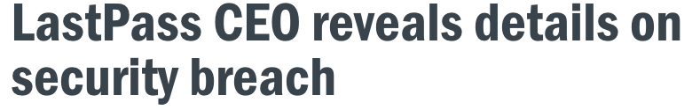
Password vault services
secret master password user remembers
Credential
from M
Ashley
Madison.com
pw
M
Encrypt
C
C
Message is set of login credential(s) for user’s websites
User-selected passwords
Automatically generated passwords
Password manager service
stores ciphertext C

Slide 39
Brute-force attacks against encryption
master password likely to fall in short sequence of guesses pw₁,pw₂,pw₃, …
pw
123456, 12345, 123456789, …
M
Encrypt
C
Message is a login credential for user’s websites. Say M has two passwords:
User-selected password
Automatically generated password
Step 1: Trial decryptions
M₁ <- Decrypt(pw₁,C)
M₂ <- Decrypt(pw₂,C)
M₃ <- Decrypt(pw₃,C)
…
C

Slide 40
Brute-force attacks against encryption
master password likely to fall in short sequence of guesses pw₁,pw₂,pw₃, …
pw
123456, 12345, 123456789, …
M
Encrypt
C
Message is a login credential for user’s websites. Say M has two passwords:
User-selected password
Automatically generated password
Most bytes won’t even be valid human-readable ASCII.
Easy to discard
Step 1: Trial decryptions
M₁ <- Decrypt(pw₁,C)
M₂ <- Decrypt(pw₂,C)
M₃ <- Decrypt(pw₃,C)
…
Step 2: Find true plaintext
M₁ = {ީ)*h?% , 趬?%?U?
M₂ = princess , AfB!541@1
M₃ = E?\Q??:? , +ܐ?Ҫ?=K`
…
C

Slide 41
Step 1: Trial decryptions
M₁ <- Decrypt(pw₁,C)
M₂ <- Decrypt(pw₂,C)
M₃ <- Decrypt(pw₃,C)
…
Step 2: Find true plaintext
M₁ = 1299827
M₂ = 6123410
M₃ = 7321162
…
C
What can we do?
Make Step 1 harder?
Make Step 2 harder?
Use better master passwords!!
Cryptographic camouflage
PKCS#5 style encryption for
bit strings known to be uniform
[Hoover, Kausik 1999]
PKCS#5 / scrypt / argon2
Make trial decryptions slower
Kamouflage password storage system
[Bojinov, Bursztein, Boyen, Boneh 10]
We give attack that breaks Kamouflage [Chatterjee et al. 15]

Slide 42
Honey Encryption (HE)
[Juels, R. – Eurocrypt 2014]
pw
M
Honey Encrypt
C
Encryption schemes tailored to specific message distributions
Always at least as secure as conventional PW-based encryption
Formal message-recovery security beyond brute-force bound.
We can show optimal decoy security in some cases:
1
Probability of
guessing
master password
Pr[message recovery] <
2^{m}

Slide 43
A framework for HE schemes
Let M be a message distribution
M ← M
pw
Honey
Encrypt
Distribution-transforming encoder
Password-based encryption
M
C
S
Randomized
encoder
Conventional PKCS#5
style encryption.
No padding, redundancy

Slide 44
A framework for HE schemes
Let M be a message distribution
M ← M
pw
Distribution-transforming decoder
Password-based decryption
M
C
S

Slide 45
A framework for HE schemes
Let M be a message distribution
M ← M
pw
Distribution-transforming decoder
Password-based decryption
M
C
S
Fresh sample from M
Fresh uniform bit string
pw’
≠ pw
Distribution-transforming decoder
Password-based decryption
M’
S’

Slide 46
HE for user-selected password
Let M be distribution of single human-generated password
M ← M
pw
Distribution-transforming decoder
Password-based decryption
M
C
S
Need to model M . How?
Key idea: use modern password crackers
for defense!
Train algorithm from password leaks
290729 123456
79076 12345
76789 123456789
59462 password
49952 iloveyou
33291 princess
…
Password cracker
List of passwords in order of
their likelihood
The cracker approximates M

Slide 47
HE for user-selected password
Let M be distribution of single human-generated password
M ← M
pw
Distribution-transforming decoder
Password-based decryption
M
salt,C
S
Need to model M . How?
Key idea: use modern password crackers
Train algorithm from password leaks
290729 123456
79076 12345
76789 123456789
59462 password
49952 iloveyou
33291 princess
…
Password cracker
List of passwords in order of
their likelihood
The cracker approximates M

Slide 48
HE for user-selected password
290729 123456
79076 12345
76789 123456789
59462 password
49952 iloveyou
33291 princess
…
Password cracker
List of passwords in order of
their likelihood
The cracker approximates M
Probabilistic context-free grammar [Weir et al. 2009]
S → W | D | Y | K | R | WW | WD | WY |…
W → <english-words>L | <names>L
D → <dates> | <numbers>
Y → <symbols>
K → <keyboard-sequence>
R → <repeated-characters>
L → Capitalize | ALL-CAPS | all-lower | L33t
Each rule set
has probability
distribution
associated
to it.
Learned from
training data.
S
W
W
n
e
We can encode a string by its parse tree, the
tree represented by probabilities in PCFG CDF
lujo
al
123
al

Slide 49
Real & decoy user-chosen passwords
First row: Master passwords (one real, others wrong)
tomrulezz | secr3tp@ss | 123456 | DuniyaIsquia
alexander19 | libr@ | love9 | daisydaisy1
chocolate19 | love | 130427 | passwordkimberly1
199019 | libra | chopperlove130427 | Carlos1
alexander9 | honeybear | diana130427 | carlos1
chocolate19 | libra | love9 | daisyyoupassword1
chocolate1 | love | love9 | carlos1
mahalkita7 | libra | charmed9 | carloscarlos1
rodriguezchocolate19 | welcome | 130427 | carlosdaisy1
199019 | love9 | diana130427 | daisy1
chocolate1 | love | dianachopper9 | carlosdaisydaisy1
alexande1 | welcome | montanalife9 | password1

Slide 50
Implemented prototype called NoCrack
pw
Credential
from M
Amazon.com
HEncrypt
M
Encrypt
C
NoCrack client
C
Full prototype system
NoCrack storage service
Human-generated or computer generated passwords
Domain name privacy mechanisms
Manager service doesn’t store any explicit hash of master password
https://www.cs.cornell.edu/~rahul/projects/NoCrack.html

Slide 51
Today’s talk
Pythia: moving beyond “hash & hope”
Harden hashes with off-system secret key using
partially oblivious pseudorandom function protocol
[Everspaugh, Chatterjee, Scott, Juels, R. – USENIX Security 2015]
Typo-tolerant password checking
In-depth study of typos in user-chosen passwords
Show how to allow typos without harming security
[Chatterjee, Athayle, Akawhe, Juels, R. – Oakland 2016]
NoCrack: password-vault based honey encryption
Decrypting a ciphertext with any number of *wrong* passwords yields fake, but plausible, plaintexts
[Juels, R. – Eurocrypt 2014]
[Chatterjee, Bonneau, Juels, R. – Oakland 2015]

Slide 53
Kamouflage [BBBB10]
abcdef12
abcdef02
abcdef#1
thomas
temple#00
0xe1f3f4a…
0x73bc52e…
0x4e5e373…
0x3c8b8ea…
0xe33188a…
Vault Ciphertext
shishi1
PKCS#5
travis99
travis12
travis@7
soccer smiles@33
0xe1f3f4a…
0x73bc52e…
0x4e5e373…
0x3c8b8ea…
0xe33188a…
violet9
PKCS#5
family00
family01
family.1
qwerty poiuyt.12
mypass4
0xe1f3f4a…
0x73bc52e…
0x4e5e373…
0x3c8b8ea…
0xe33188a…
PKCS#5
scooby33
scooby45
scooby@3
vanbus weiwei!69
0xe1f3f4a…
0x73bc52e…
0x4e5e373…
0x3c8b8ea…
0xe33188a…
zxcvbn9
PKCS#5

Slide 54
Naïve brute-force attack against Kamouflage
Attacker’s ordering
of master password guesses
Kamouflage
Vault Ciphertext
123456
password
Iloveyou
…
…
violet9
…
…
mypass4
abc123
nicole
Daniel
.
.
.
Random Junk
ɡɠڅ0&c#a&a339019f*a2;19dd229趬6%7a'82c0%ф݇ःФs?
Decryption
(Kamouflage)

Slide 55
Naïve brute-force attack against Kamouflage
Attacker’s ordering
of master password guesses
Kamouflage
Vault Ciphertext
Real Vault??
123456
password
Iloveyou
…
…
violet9
…
…
mypass4
abc123
nicole
Daniel
.
.
.
travis99
travis12
travis@7
soccer smiles@33
Decryption
(Kamouflage)

Slide 56
Naïve brute-force attack against Kamouflage
Attacker’s ordering
of master password guesses
Kamouflage
Vault Ciphertext
Real Vault??
123456
password
Iloveyou
…
…
violet9
…
…
mypass4
abc123
nicole
Daniel
.
.
.
family00
family01
family.1
qwerty poiuyt.12
Decryption
(Kamouflage)

Slide 57
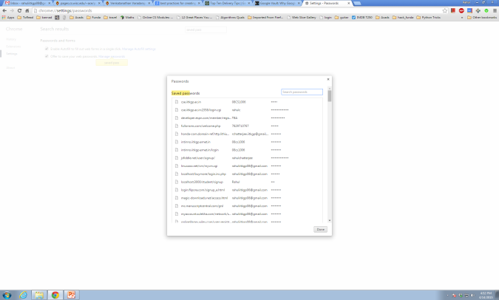
Naïve brute-force attack against Kamouflage
shishi1 violet9 mypass4 zxcvbn9
abcdef12
abcdef02
abcdef#1
thomas
temple#00
travis99
travis12
travis@7
soccer smiles@33
family00
family01
family.1
qwerty poiuyt.12
scooby33
scooby45
scooby@3
vanbus weiwei!69
?
Only Option: Try passwords at sites
Runtime of the Attack =
Offline Work + Online Work
Authors goal:
All Offline Work + N/2 online queries (avg.)
(Where N = Number of explicitly stored vaults)

Slide 58
We found a vulnerability
family00
family01
family.1
qwerty poiuyt.12
W₆D₂
W₆D₂¹
W₆S₁D₁
W₆¹
W₆²S₁D₂²
Templates
Real
mypass4
W₆D₁
{
abcdef12
abcdef02
abcdef#1
thomas
temple#00
travis99
travis12
travis@7
soccer smiles@33
scooby33
scooby45
scooby!3
vanbus weiwei!69
Decoys
....
shishi1
violet9
zxcvbn9
All master passwords share the same template
Notes:
Every password is converted into an intermediate

Slide 59
Attacking Kamouflage
Kamouflage
Vault Ciphertext
Attacker’s ordering
of master password guesses
Random Junk
…
…
veronica
viper01
violet9 whatsup!
Wlidcat2
year2012
secret7
…
…
mypass4
ࠕѦܷ३ءф֗ʅɤܒѵ؉Ѱॸݢաܢٓं֑٠є͈̇Ճऒиࡲेѓঀ१Җ֒РԄΙҀݹऩݠ
Decryption
(Kamouflage)

Slide 60
Attacking Kamouflage
Kamouflage
Vault Ciphertext
Attacker’s ordering
of master password guesses
Plausible Vault
…
…
veronica
viper01
violet9 whatsup!
Wlidcat2
year2012
secret7
…
…
mypass4
Decryption
(Kamouflage)
travis99
travis12
travis#7
soccer smiles#33
Master Password Template: W₆D₁

Slide 61
Attacking Kamouflage
Kamouflage
Vault Ciphertext
Attacker’s ordering
of master password guesses
Random Junk
…
…
veronica
viper01
violet9 whatsup!
Wlidcat2
year2012
secret7
…
…
mypass4
Decryption
(Kamouflage)
١ʇեर࢒ݠТ݈ր͖ृݩ̣ܔܢԳ঒̡̹ࢗ΄ݖऐख२࢓ձճʙЖ͇ـগउШɱ݀йԐգै̷ѡʂ̀
Master Password Template: W₆D₁
SPEED UP:
Ignore the passwords that
do not match the template

Slide 62
Simulated Attack Results
Kamouflage claimed (for N=1,000):
100% offline work of standard Password Based Encryption
+
N/2 = 500 online queries (avg.)
We found:
50% offline work of standard Password Based Encryption
+
11 online queries (avg.)
Notes:
Cracking any of the N master passwords reveals the template of the mpw, which narrows down the search space to the password matching the tempalte.
The decoys are pretty easily distinguishable.
Please see the paper for detailed description of the attack.

Slide 63
The Pythia PRF Service
Approach |  | DB exfiltration protection | Key rotation | Hides passwords from backend
Password hashing
HMAC back-end |  | Yes | No | No
Encryption |  | Yes | O(n) or reveal keys to server | No
Pythia |  | Yes | O(1) | Yes

Slide 64
The Pythia PRF Service
tom, password1
id, blinded h
K
f = F(K, h)
Back-end
crypto
service
h = H^{c}(password1|| salt)
Store only f
Cryptographically erases all data attacker stole
Combine token and f
to generate f’ = F(K’,h)
K
Token(K->K’)
Back-end
crypto
service
Server learns nothing about K or K’
K’

Slide 65
The Pythia PRF Service
tom, password1
id, blinded h
K
f = F(K, h)
Back-end
crypto
service
h = H^{c}(password1|| salt)
Store only f
Cryptographically erases all data attacker stole
Combine token and f
to generate f’ = F(K’,h)
K
Token(K->K’)
Back-end
crypto
service
Server learns nothing about K or K’
K’

Slide 66
The Pythia PRF Service
id, blinded h
princess
K
f = F(K, h)
Back-end
crypto
service
h = H^{c}(princess|| salt)
Store only f
Stronger privacy properties via blinding of values derived from password
Forces compromised server to reveal query patterns
New cryptography: partially-oblivious PRF
Multi-tenant (theoretically: scales to 100 million servers)
Prototype and paper:
http://pages.cs.wisc.edu/~ace/pythia.html

